Slide 1
Remote Repositories, Branches, gitconfig,and gitignore
By: Tilon bobb, Omran Khoja, igal Haimovitz, betty zhang

Slide 2
INTRODUCTION
1
Github is an essential tool in software development collaboration that provides a remote version-controlled repository that allows others to view and contribute to your project. Before we can learn about how Github helps us collaborate with others, we first need to understand how it works ourselves.

Slide 3
Working with Remote Repositories
SYNCING remote and LOCAL Repositories

Slide 4
OVERVIEW
2
The basic idea behind a Github remote repository is that it is linked to a local repository on your computer.
While they are linked, they will not always be identical.
Changes made on your computer will not automatically reflect on the remote and changes made on the remote will not automatically reflect on the local machine.
Let’s take a look at some examples.

Slide 5
Example 1
3
On our local repository, let’s create and commit a simple text file that says, “Hello World!”
We will use the following commands:
touch <fileName> – creates a file with the specified name.
open <fileName> – opens the specified file.
git add <fileName> – adds any changes in the specified file to a staging area.
git commit -m <message> – commits the changes in the staging area with the specified message.

Slide 6
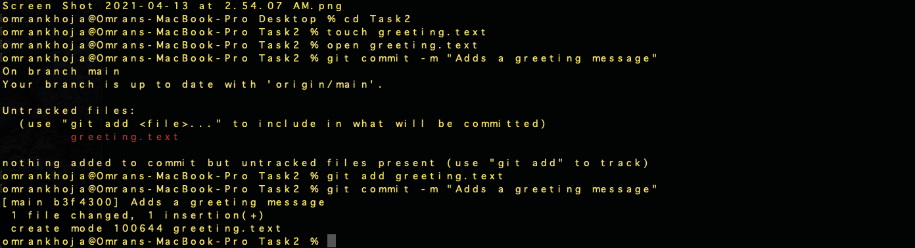
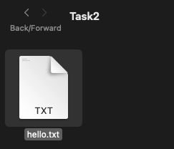
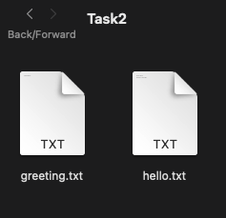

Example 1 (cont.)
4
➔
➔

Slide 7
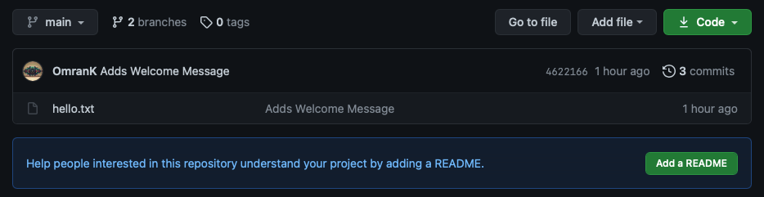
Example 1 (cont.)
3
We can see that the “greeting.txt” file is not automatically present in our remote repository.

Slide 8
Git Push
2
We need to manually sync the remote repository with the changes on the local one.
We will use the following command:
git push – pushes local commits to the remote repository.

Slide 9
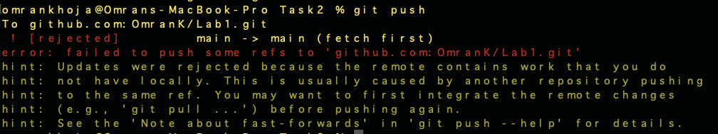
Conflicts/Push Rejection (cont.)
2
We can see here that the push was rejected and looking at the hints we can see that the reason is that the remote repository has some changes that are not present in our local copy which resulted in a conflict.

Slide 10
Conflicts/Push Rejection (cont.)
2
Conflicts like this can occur when you make a commit directly on the remote repository or push a commit to the remote repository from another computer. These changes are not present on the local machine.
(In this case the hello.txt was modified in the browser)

Slide 11
Git Pull
2
To avoid conflicts like this, it is best to always to manually sync the local repository with the changes on the remote one before you make any changes.
To do this use the following command:
git pull – copies the remote changes to the local repository.

Slide 12
Resolving the Conflict
2
Since we did not do a pull before we made changes to the local file, it becomes a little more complicated to fix this issue.
Let’s take a look at why.

Slide 13
Resolving the Conflict (cont.)
2
To understand the conflict, let’s examine the structure of both repositories.
Remote Repository has 1 file:
hello.txt:
“Hello, World!”
“Welcome to CISC 3140”
Local Repository has 2 files:
hello.txt:
“Hello, World!”
greeting.txt:
“Hello, World!”
Both repositories have unique changes (commits) that aren’t present in the other.

Slide 14
Resolving the Conflict (cont.)
2
The remote repository will not accept any push due to this conflict and suggests you first perform a pull.
If you pull the changes from the remote repository, it will cause a merge conflict. The local file can’t sync with the remote because it has unique changes (commits) of its own.
What do we do?

Slide 15
Resolving the Conflict (cont.)
2
To fix this type of conflict, we will pull using rebasing which updates the local repository with the changes from the remote while avoiding the merge conflicts.
We will use the following command:
git pull -r – pulls the remote commits into the correct place (before local commits).
Let’s examine the effect of this on the local repository.

Slide 16
Resolving the Conflict (cont.)
2
The structure of the local repository after a rebased pull:
Local Repository has 2 files:
hello.txt:
“Hello, World!”
“Welcome to CISC 3140”
greeting.txt:
“Hello, World!”
We can see that the local repository has accepted the changes from the remote repository while keeping its own unique changes.

Slide 17
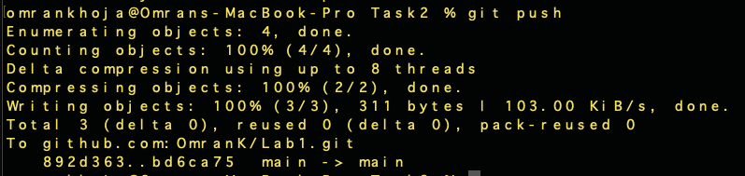
Git Push (Finally)
2
Now that the conflict has been resolved, we can sync the remote repository with the changes we made on our local machine.

Slide 18
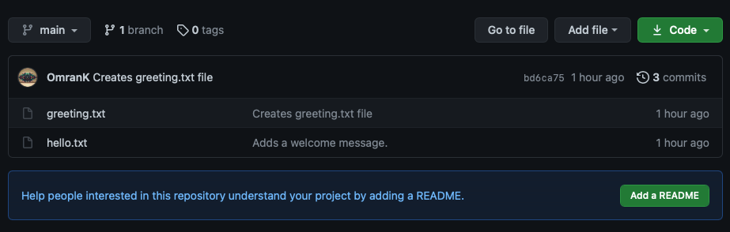
Git Push (Finally)
2
The two repositories are finally synced. Remember to always pull any changes from the remote before modifying the local copy to avoid the pitfalls of merge conflicts!

